Slide 1
INTRODUCTION TO MATLAB FOR SIGNAL PROCESSING
EE 301

Slide 2
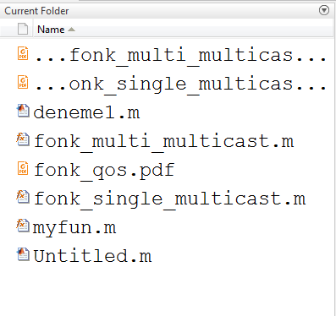
MATLAB ENVIRONMENT
Current Folder : This panel allows you to access the project folders and files.

Slide 3
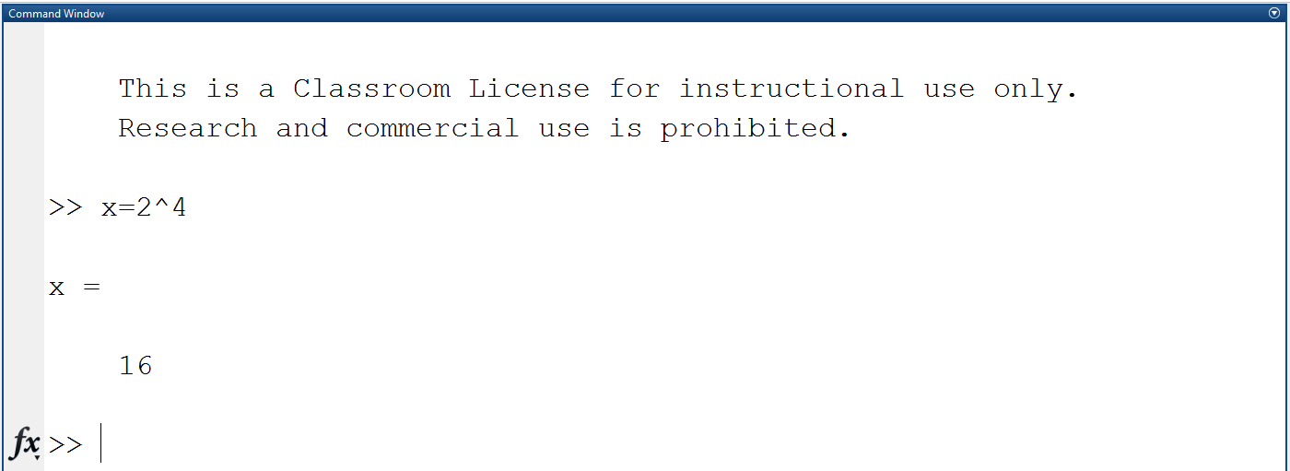
MATLAB ENVIRONMENT
Command Window : This is the main area where commands can be entered at the command line. It is indicated by the command prompt (>>).

Slide 4
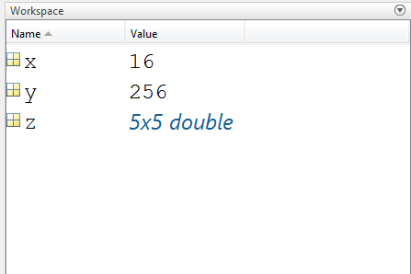
MATLAB ENVIRONMENT
Workspace: The workspace shows all the variables created and/or imported from files.

Slide 5
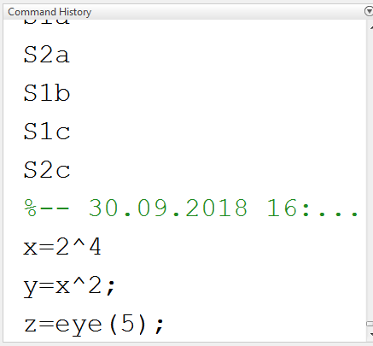
MATLAB ENVIRONMENT

Slide 6
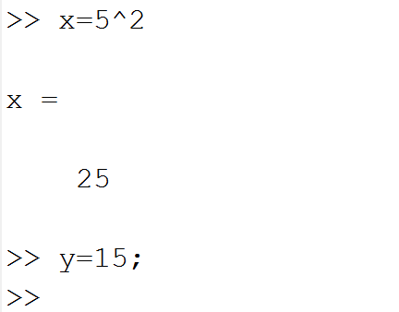
Semicolon (;)
If you want to suppress and hide the MATLAB output for an expression, add a semicolon after the expression.

Slide 7
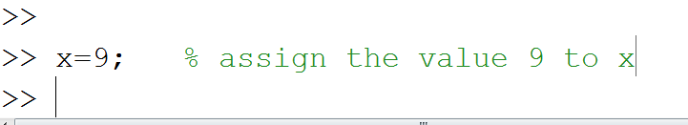
Percent Symbol (%)
The percent symbol (%) is used for indicating a comment line.

Slide 8
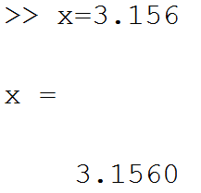
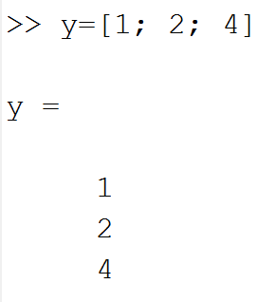
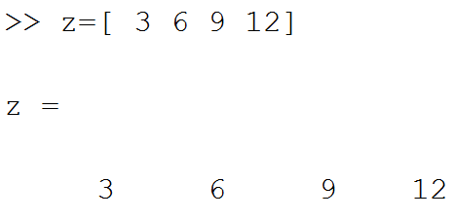
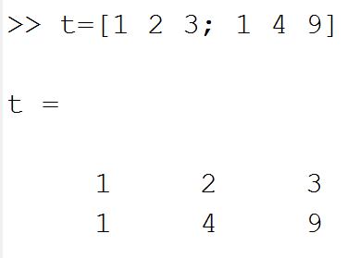
Variables
In MATLAB, the basic variable is a matrix, or an array.
The followings are 4 types of matrices.
Scalar 2) Column Vector
3) Row Vector 4) General Matrix

Slide 9
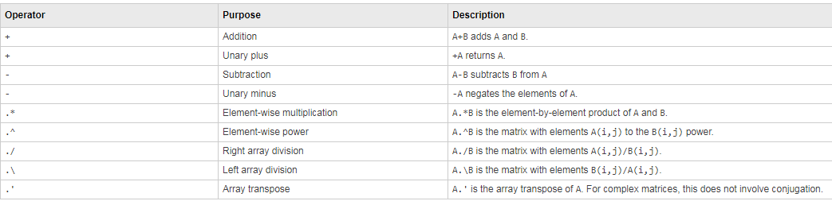
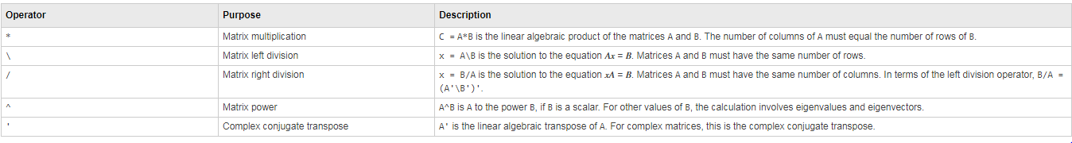
Arithmetic Operations

Slide 10
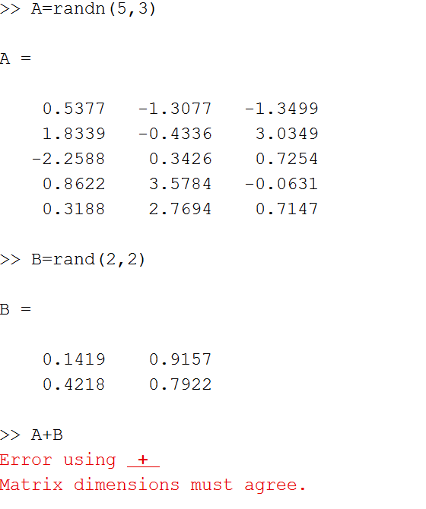
Arithmetic Operations

Slide 11
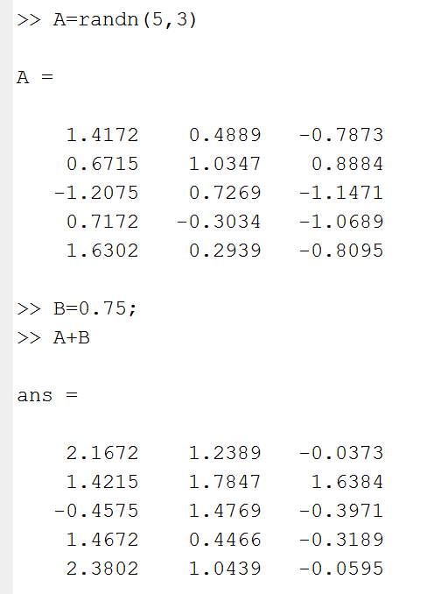
Arithmetic Operations

Slide 12
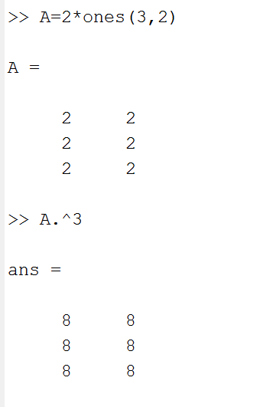
Arithmetic Operations

Slide 13
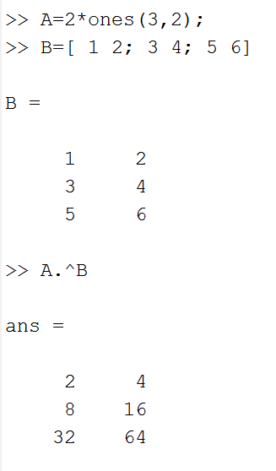
Arithmetic Operations

Slide 14
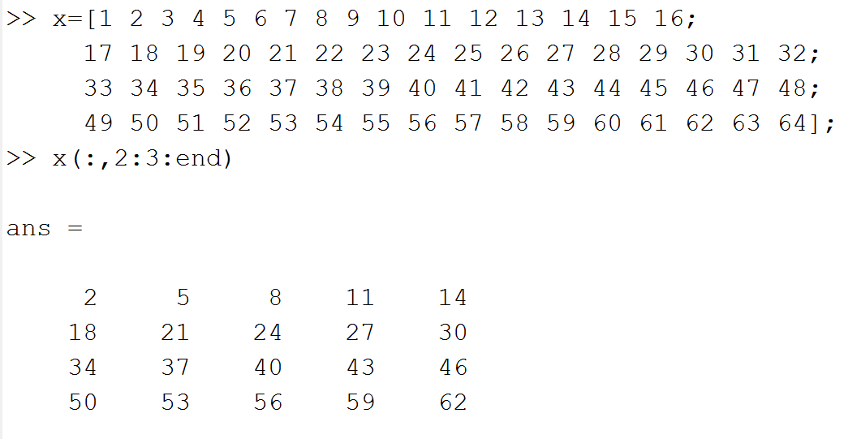
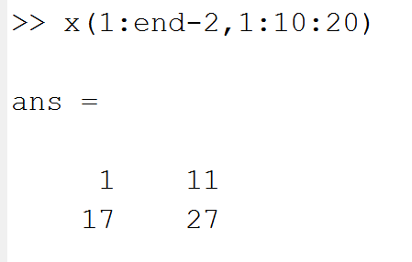
Indexing Operations

Slide 15
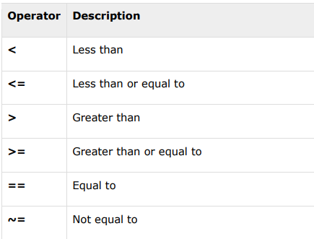
Relational Operations

Slide 16
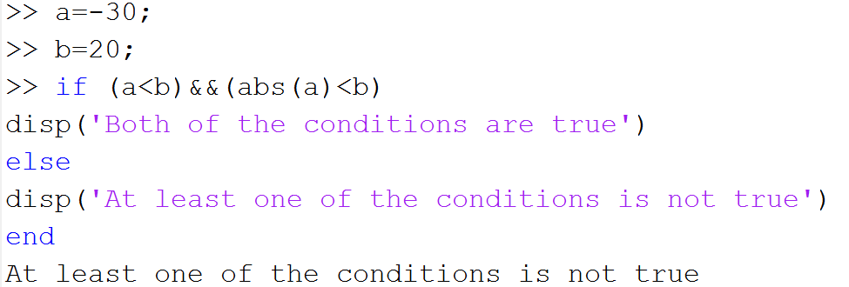
Logical Operations

Slide 17
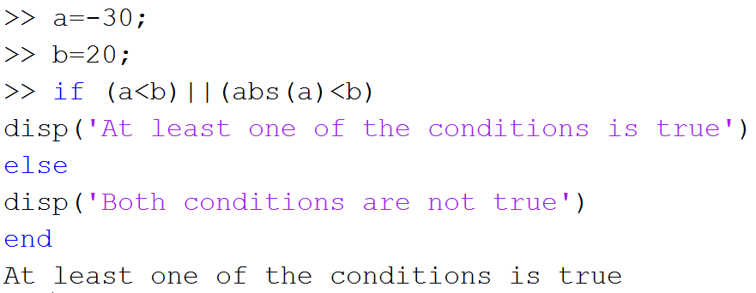
Logical Operations

Slide 18
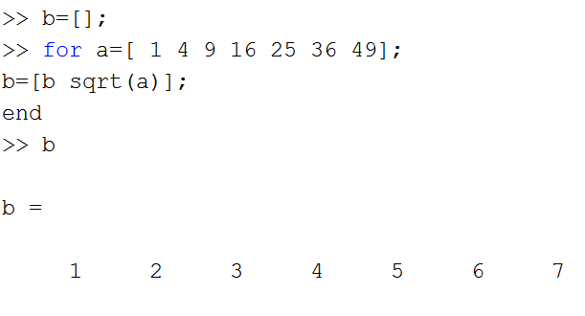
Flow Control

Slide 19
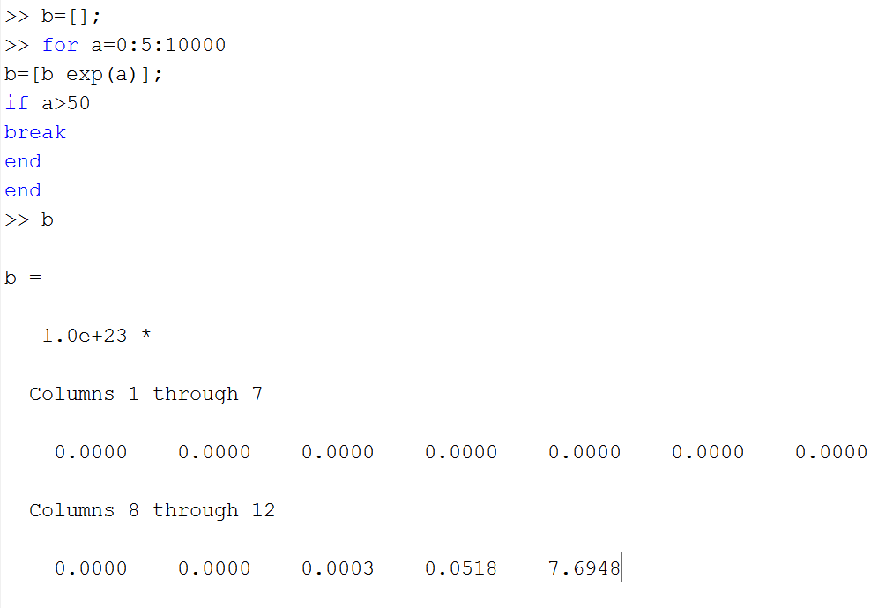
Flow Control

Slide 20
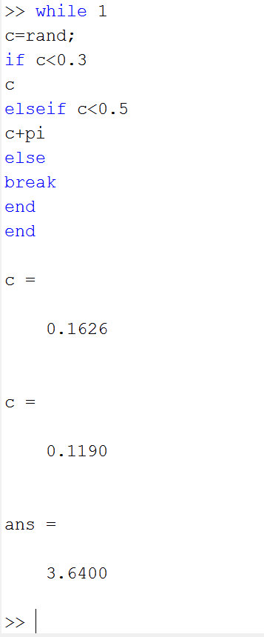
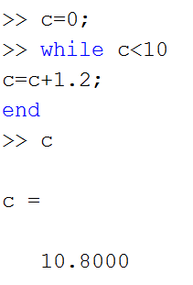
Flow Control

Slide 21
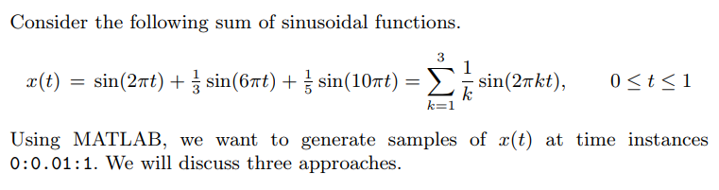
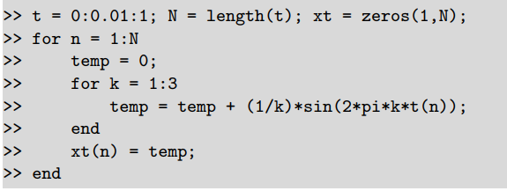
Example
Approach 1:

Slide 22
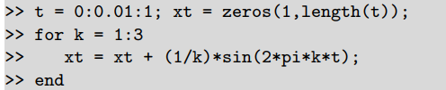

Example
Approach 2:
Approach 3:
This is the most compact code and the most efficient execution in MATLAB, especially when the number of sinusoidal terms is very large.

Slide 23
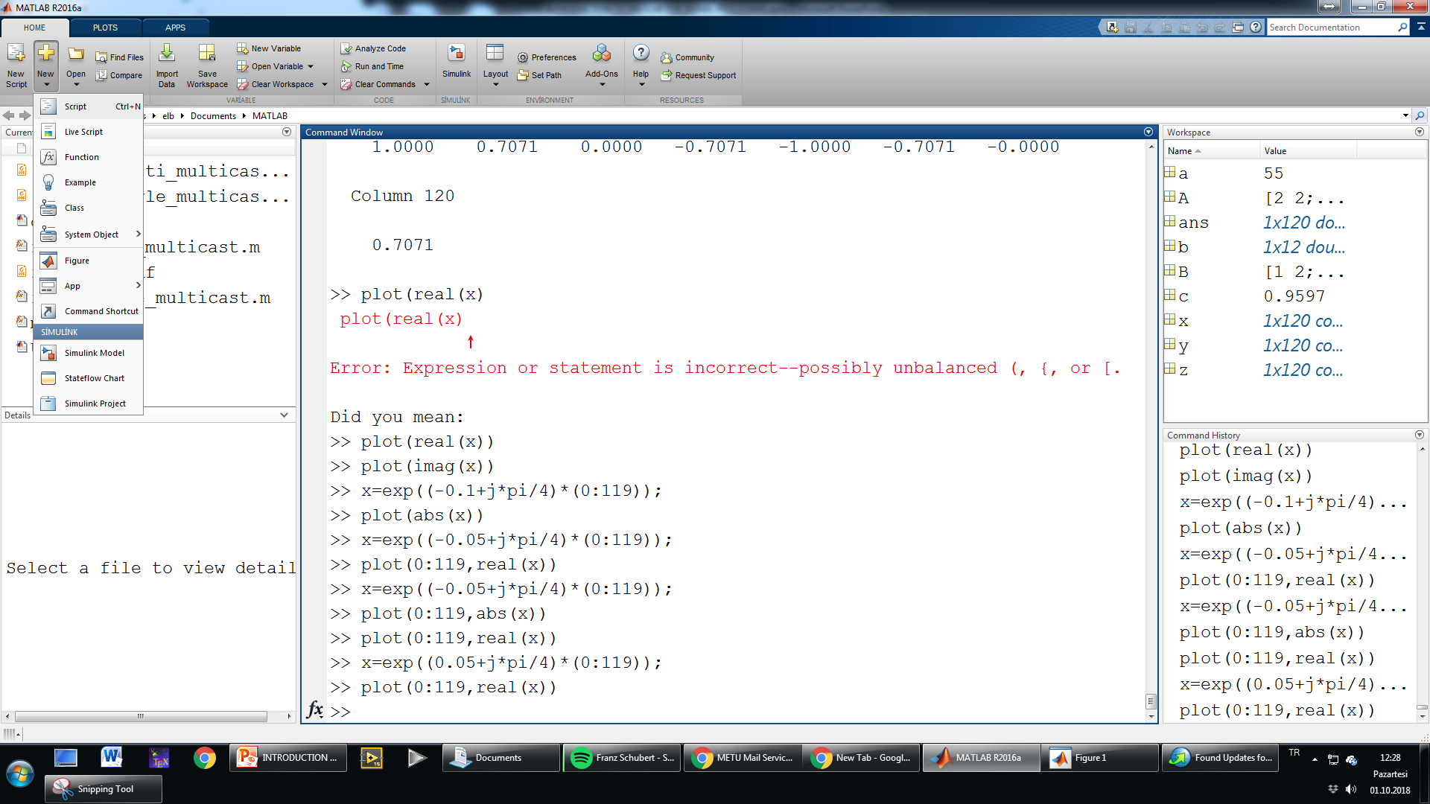
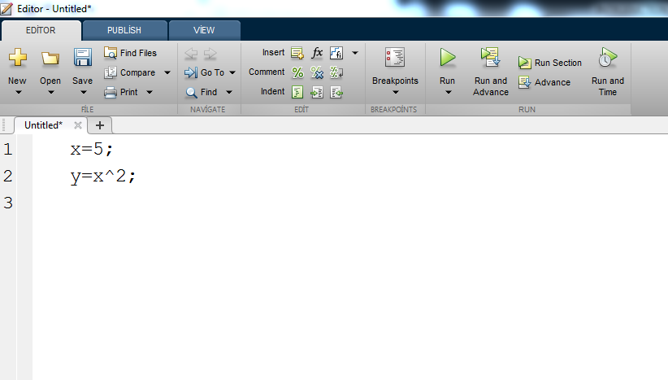
Scripts

Slide 24
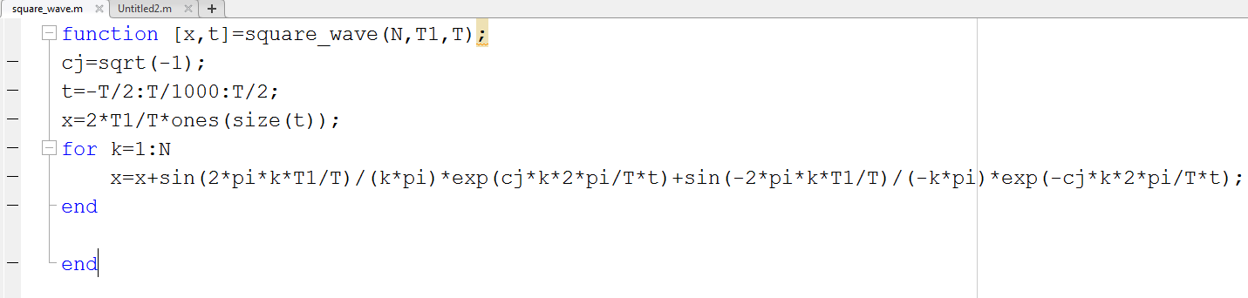
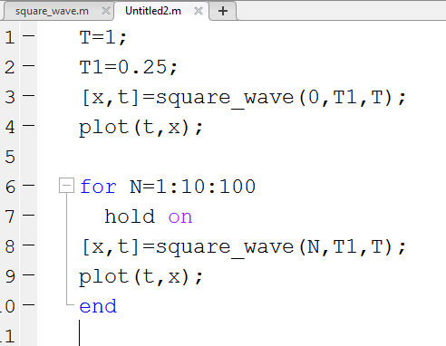
Functions

Slide 25
Gibbs Phenomenon

Slide 26

Sinusoidal Signals
Period= 8 samples

Slide 27
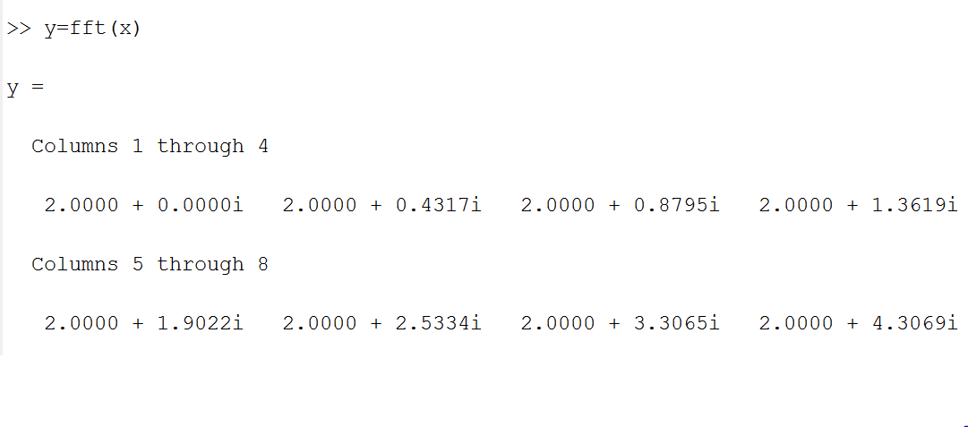
Sinusoidal Signals
.
.
.

Slide 28

Sinusoidal Signals

Slide 29
Sinusoidal Signals

Slide 30

Sinusoidal Signals

Slide 31
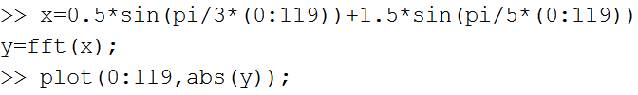
Sinusoidal Signals

Slide 32
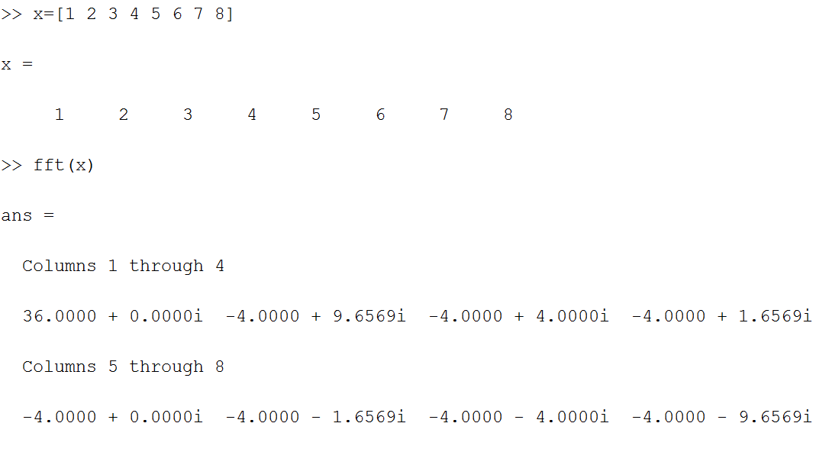
Fourier Transform for Real Signals
DC value
complex conjugate

Slide 33


Complex Exponential Signals

Slide 34

Complex Exponential Signals

Slide 35


Complex Exponential Signals

Slide 36

Complex Exponential Signals

Slide 37


Real Sinusoidal Signals vs. Complex Exponential Signals

Slide 38
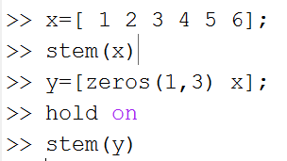
Basic Signal Transformations
Time Shift

Slide 39
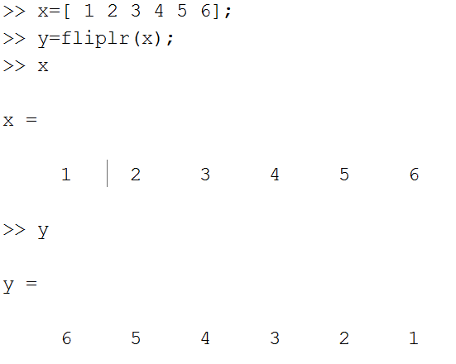
Basic Signal Transformations
Time Reversal

Slide 40
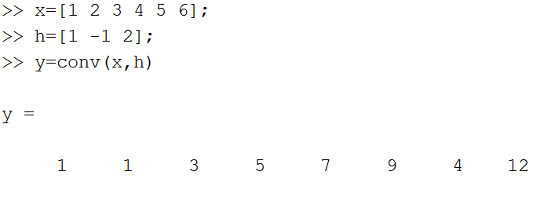
Convolution in Time
Convolution corresponds to filtering.
It corresponds to multiplication in fequency domain.

Slide 41
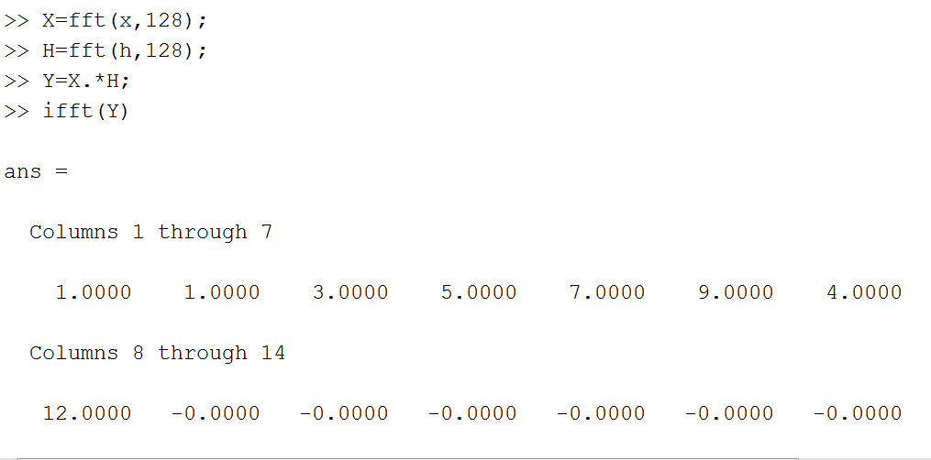
Multiplication in Frequency

Slide 42


Lowpass Filtering

Slide 43

Lowpass Filtering

Slide 44
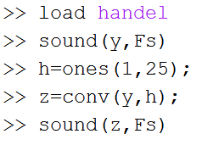


Lowpass Filtering

Slide 45


Highpass Filtering

Slide 46
Highpass Filtering

Slide 47
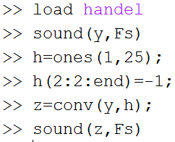
Highpass Filtering

